Slide 1

Welcome to my presentation

Slide 2

Name: Shajmin Akter
Id: 222-34-712
Section: 222A

Slide 3
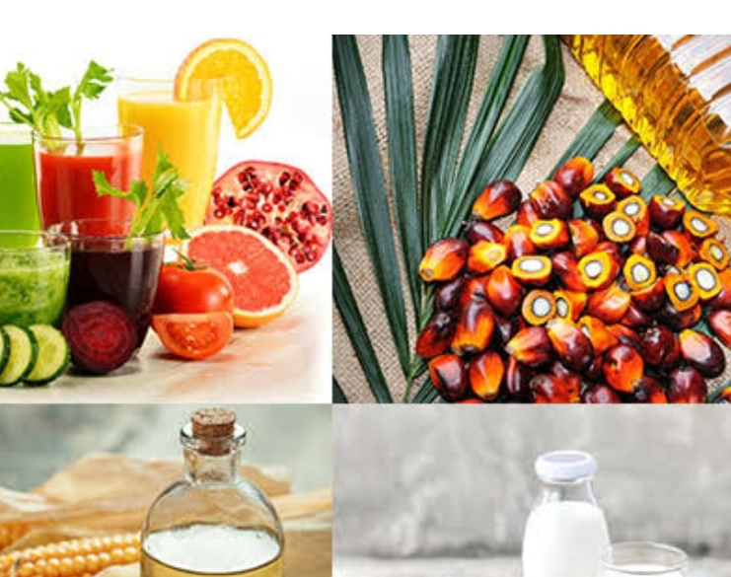
Topic: Application of Sorting&Grading in food industry

Slide 4
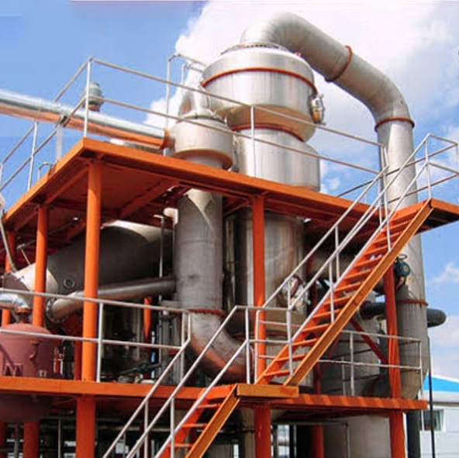
Introduction: Sorting is a separation based on an individual physical properties of raw materials such as weight, size, shape, density, photometric property, etc. while grading is classification on the basis of quality incorporating commercial value, end use and official standards.

Slide 5
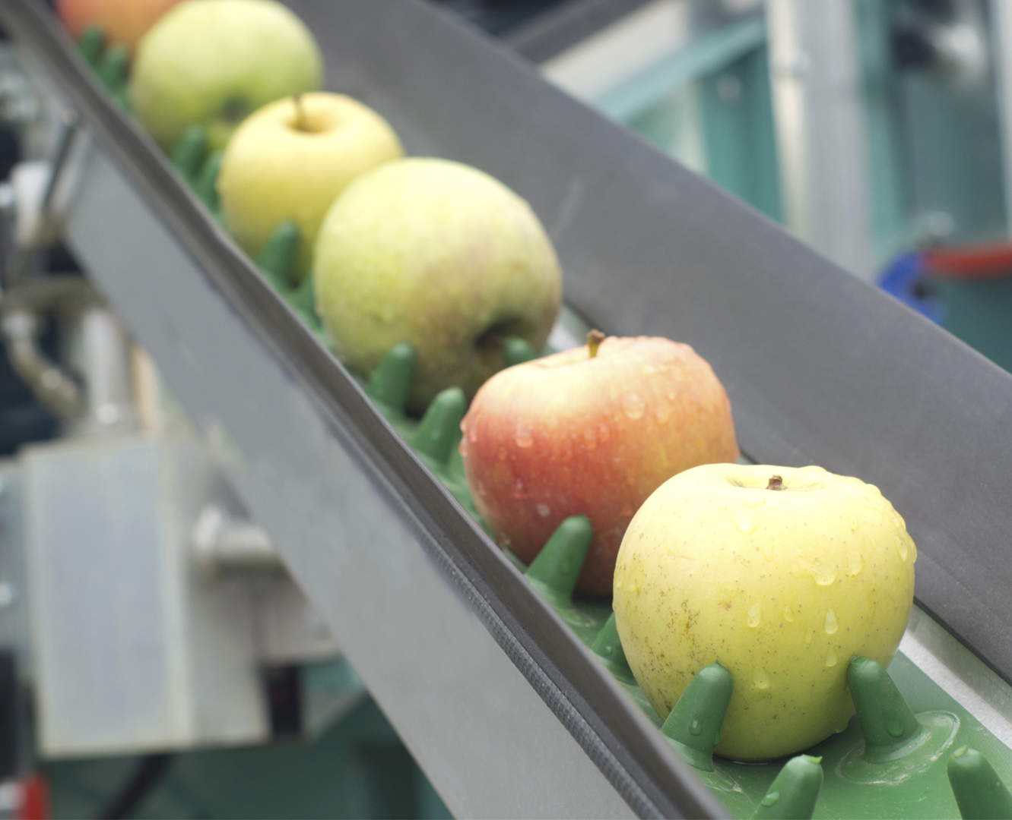
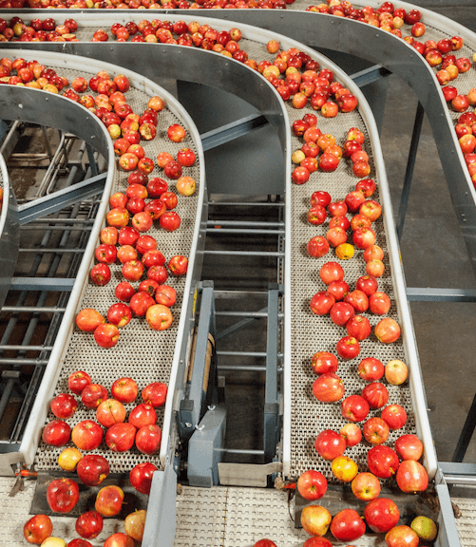
Application Of Sorting
Sorting of raw materials
Sorting of processed food
Sorting of size
Application Of Grading
Quality assurance
Product classification
Regulatory compliance

Slide 6
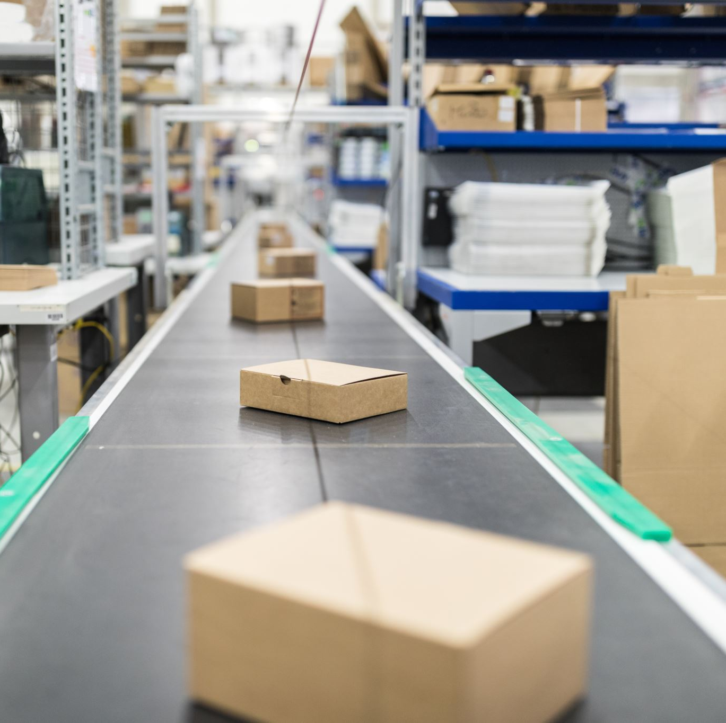
Techniques Used in Sorting And Grading
Optical sorting
Manual sorting
Mechanical grading

Slide 7
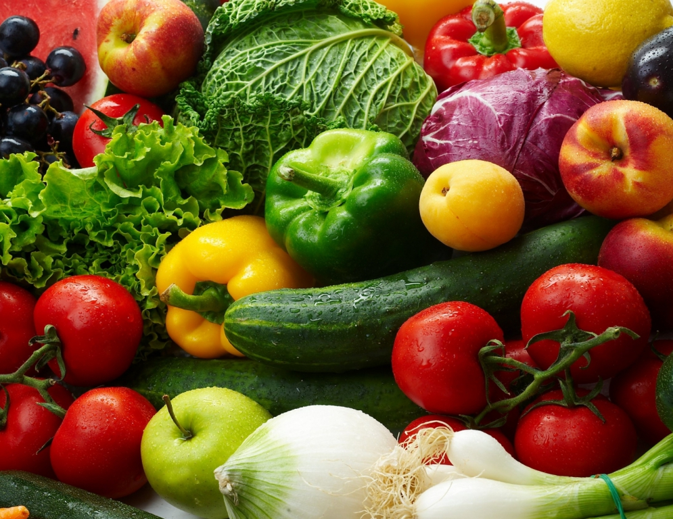
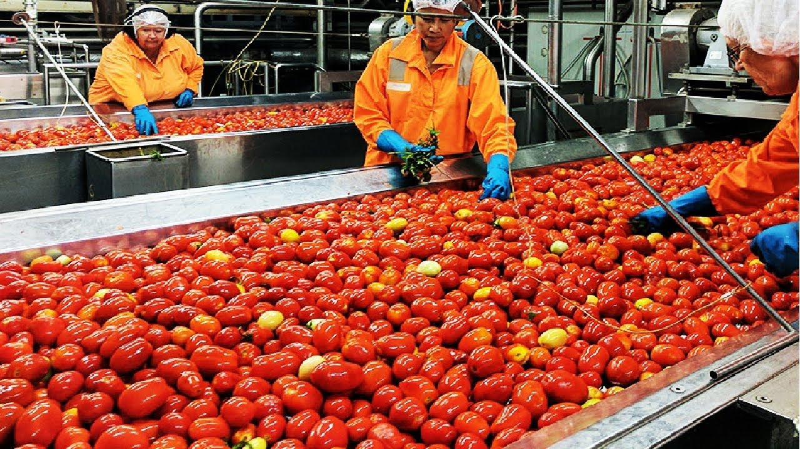
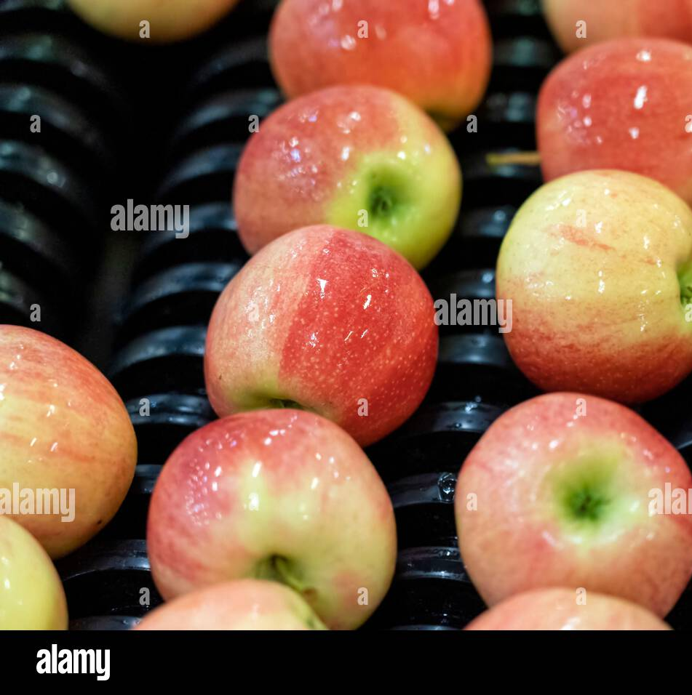
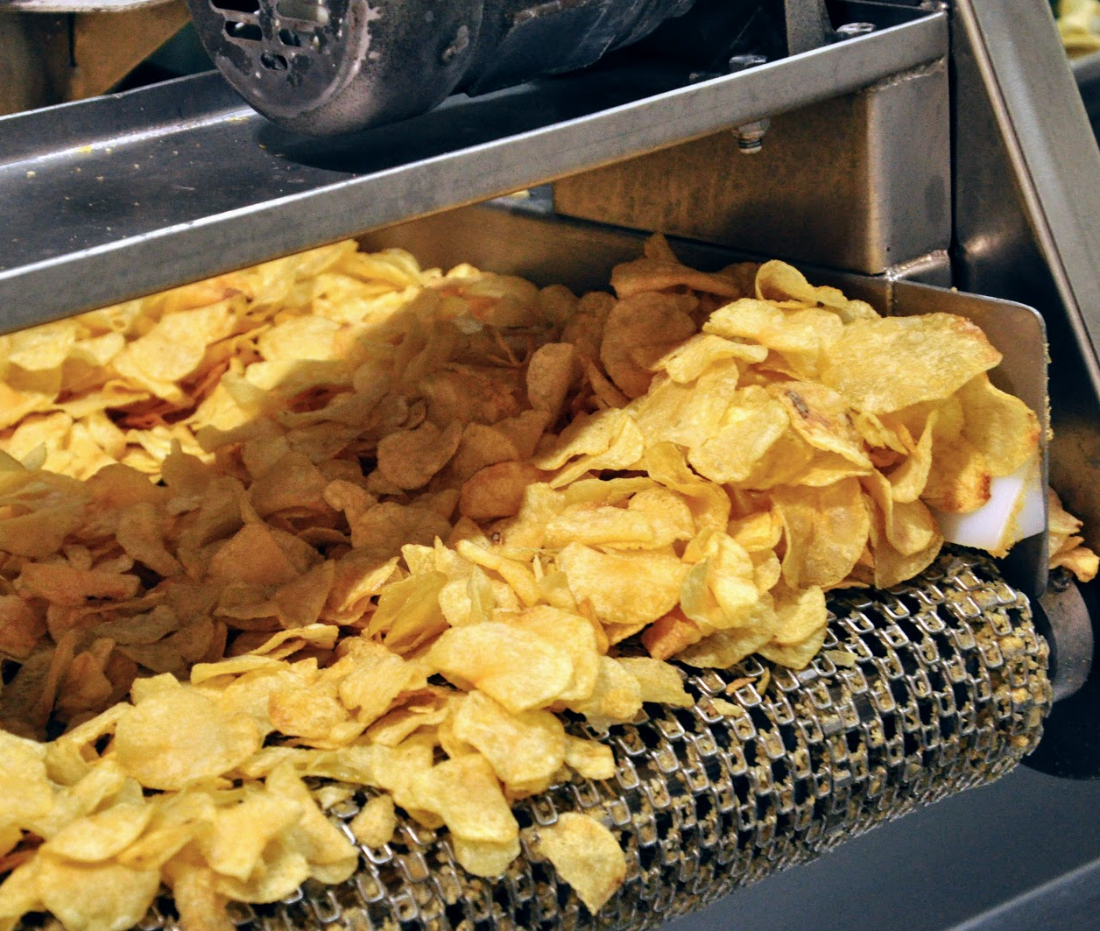
Where sorting and grading can be used
Tomato processing
Mango processing
Fruits processing
Vegetable processing
Potato chips processing
Sorting machines can be used in the food processing industry for sorting and categorizing fruits empty bottles, crates, and other items.

Slide 8
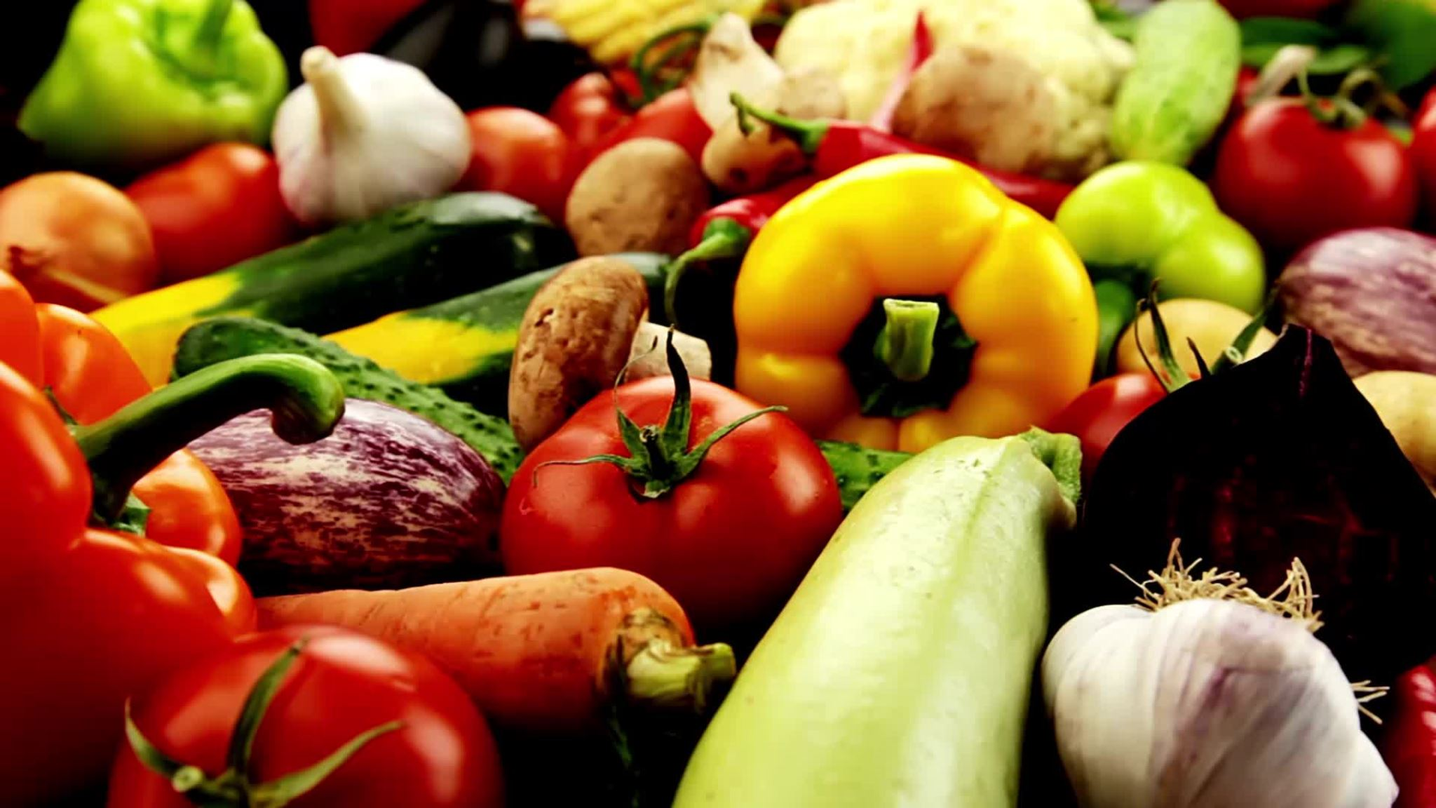
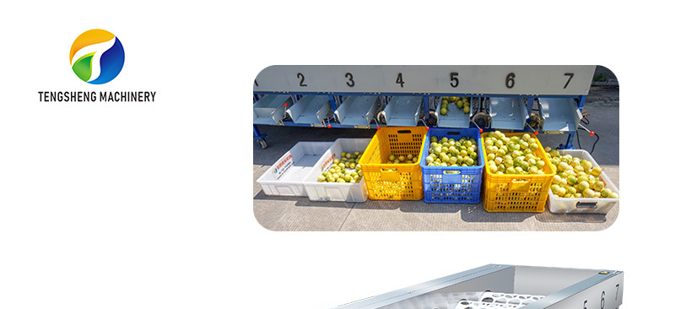
Advantages Of Sorting & Grading
Improved product quality: Sorting and grading help to ensure that only high-quality food products are packaged and sold to consumers.
Increased efficiency: Sorting and grading help to reduce waste and improve efficiency in the food industry.
Compliance with regulations: Sorting and grading help to ensure that food products meet regulatory requirements and are safe for consumption.

Slide 9
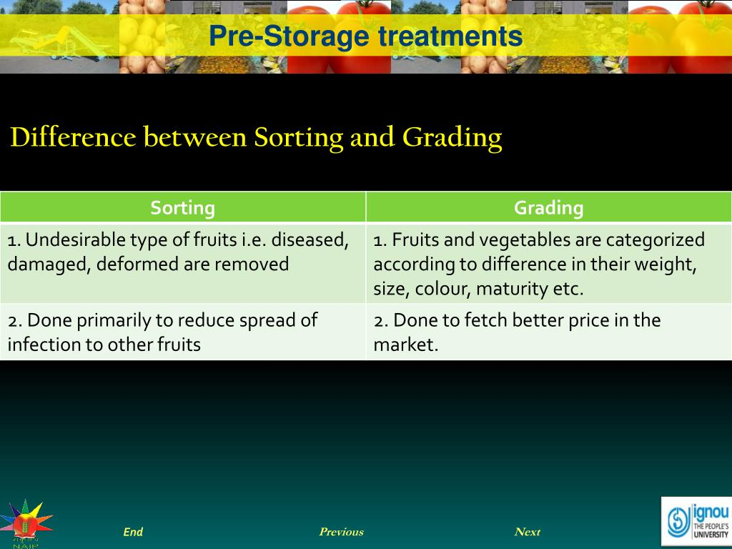
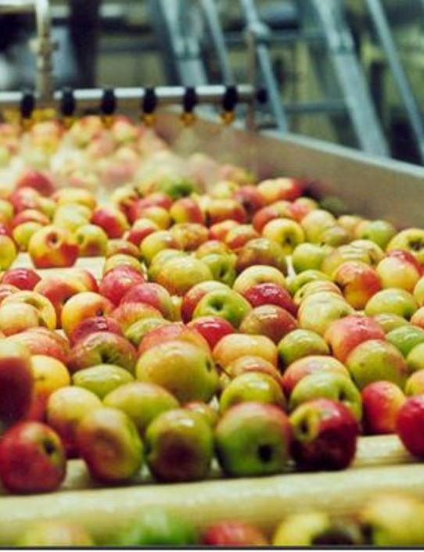

Slide 10


